Slide 1

Sustainable Development Strategies in Agriculture and Rural Development
Made by/ Youniss Mohammed Youniss & Mahmoud Abdelhamid Elsayed

Slide 2

Outline of this Presentation
Why is Agriculture so Important for Poverty Reduction and Sustainable Rural Development?
General Principles for Sustainable Development
What are objectives?
How to best accomplish them?
Principles for effective public interventions
Five Dimensions of Sustainable NRM & Development
Reducing land degradation
Improving water management
Sustainable forestry
Sustainable fisheries
Incorporating global warming into development planning
The Role of Trade in Agriculture and Rural Development

Slide 3
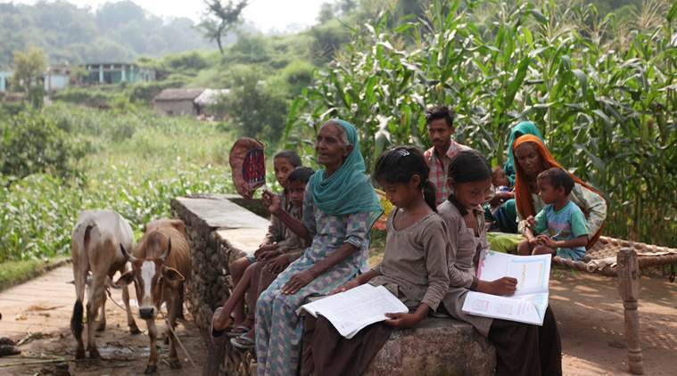
Agriculture, Poverty and Rural Development

Slide 4
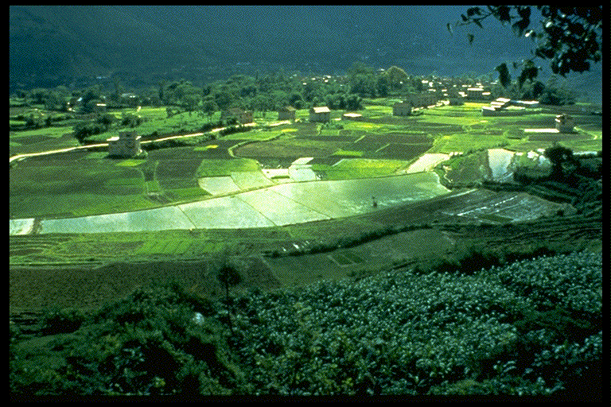
Why is sustainable agriculture so important for developing countries and the rural poor?
63 percent of population live in rural areas
73 percent of poor live in rural areas
Agriculture and agro-processing account for 30-60 percent of GDP in developing countries, and an even larger share of employment
Even with rapid urbanization, more than 50% of the poor will be in rural areas by 2035, and depend significantly on agriculture

Slide 5
Sustainable Development Principles (How?)
Correct the over-exploitation or inappropriate use of resources by ensuring that all environmental services are correctly valued (internalize the externalities)
Establish projects and policies on appropriate levels -- community, watershed, national, regional, global – generally with corresponding implementation/ financing mechanisms
Incorporate institutional development and new technologies
Reduce risks and vulnerabilities of farming communities
Diversify cropping systems for economic and environmental resilience
Weather forecasting to aid planting date and management decisions.
Weather and price crop insurance.

Slide 6
Elements of Sustainability for Rural Development
Reducing land degradation
Improving water management
Sustainable forestry
Sustainable fisheries
Incorporating global warming into development planning

Slide 7
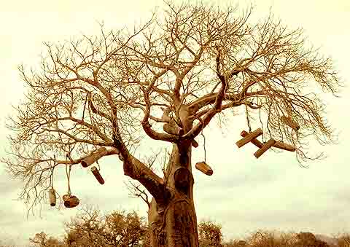
Reducing land degradation
Increase productivity on the “best” land
Diversify agroecosystems to protect food systems, improve diets, minimize risks, diversify incomes, and conserve agrobiodiversity
Rehabilitate productivity and ecosystem functions of degraded lands to enhance environmental roles e.g. C sequestration – BioCarbon fund.
Technologies include integrated soil fertility management, adapted varieties, crop rotations, conservation tillage, buffer strips, and organic farming
Strengthen local institutions and facilitate community-driven land and water resource management for managing shocks, stresses, and global trade barriers

Slide 8
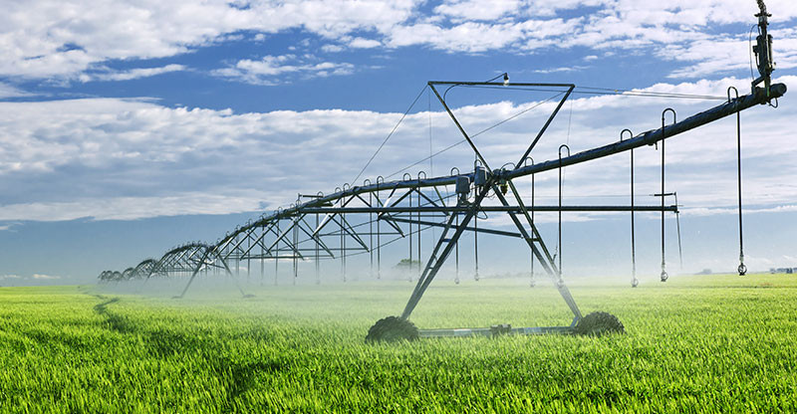
Improving water management

Slide 9
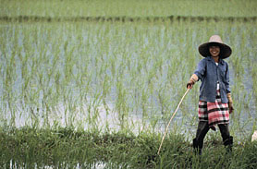
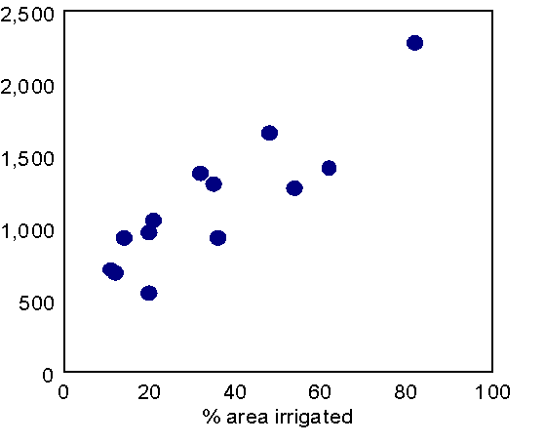
Irrigation has been successful in lifting many rural poor out of poverty…trick is to do it in a sustainable manner
Average income levels & irrigation intensity in India

Slide 10
Challenges in water management
Small stocks of water infrastructure in developing countries compared to those in climatically similar industrial countries
Simultaneous need for institutional solutions/ reforms
Pricing for fiscal sustainability and to encourage conservation (agriculture uses about 70% of water, and is very wasteful)
Ownership and devolution of management responsibility
Urgency in developing an integrated package of structural and non-structural tools which respond to the imbalances by human demand and hydrologic patterns accentuated by global changes

Slide 11
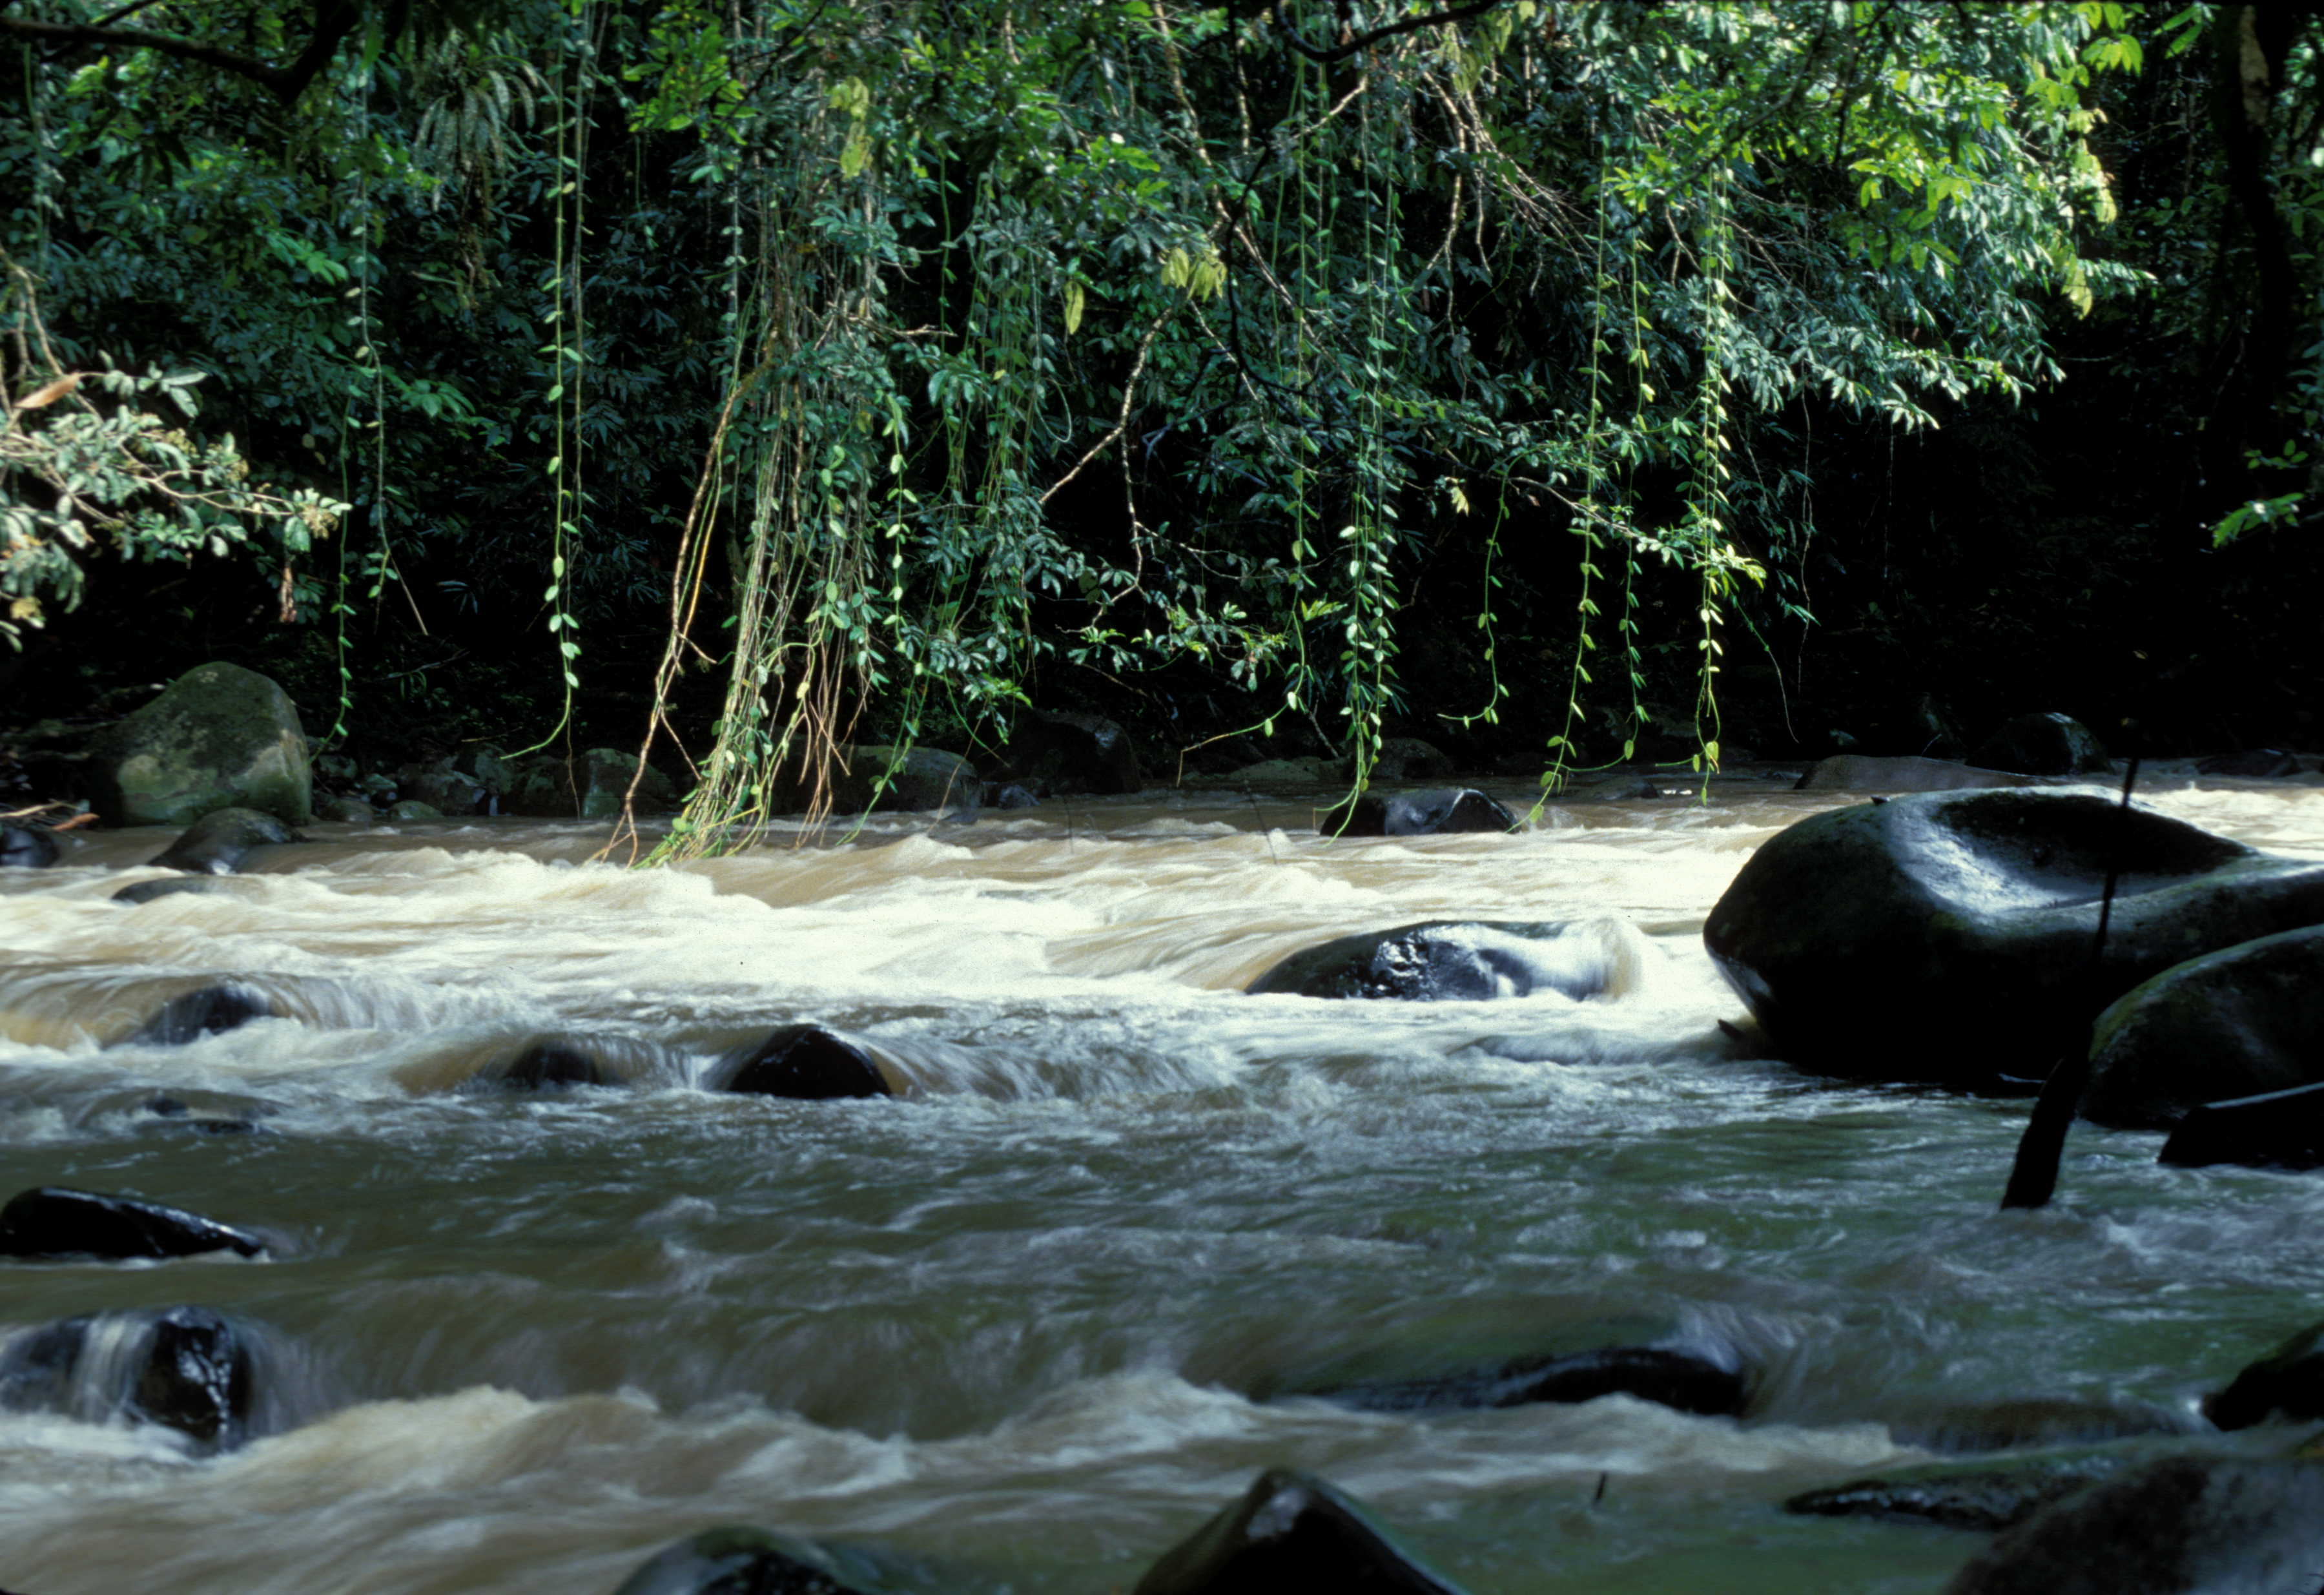
Making Forestry more Sustainable

Slide 12
Forests are especially important to the poor…
1.6 billion rural people are dependent upon forests to some extent.
1 billion out of 1.2 billion extremely poor depend on forest resources for part of their livelihoods
350 million people are highly dependent on forests.
60 million indigenous people are almost wholly dependent on forests.
Source: World Bank Forests Strategy and Policy, 2002.
Country | Forest Dependent Population
India | 275 million
Congo | 62.6 million
Indonesia | 40-70 million
Myanmar | 25 million
Vietnam | 20 million
Turkey | 8 million
Source: APFSOS, WP/27

Slide 13
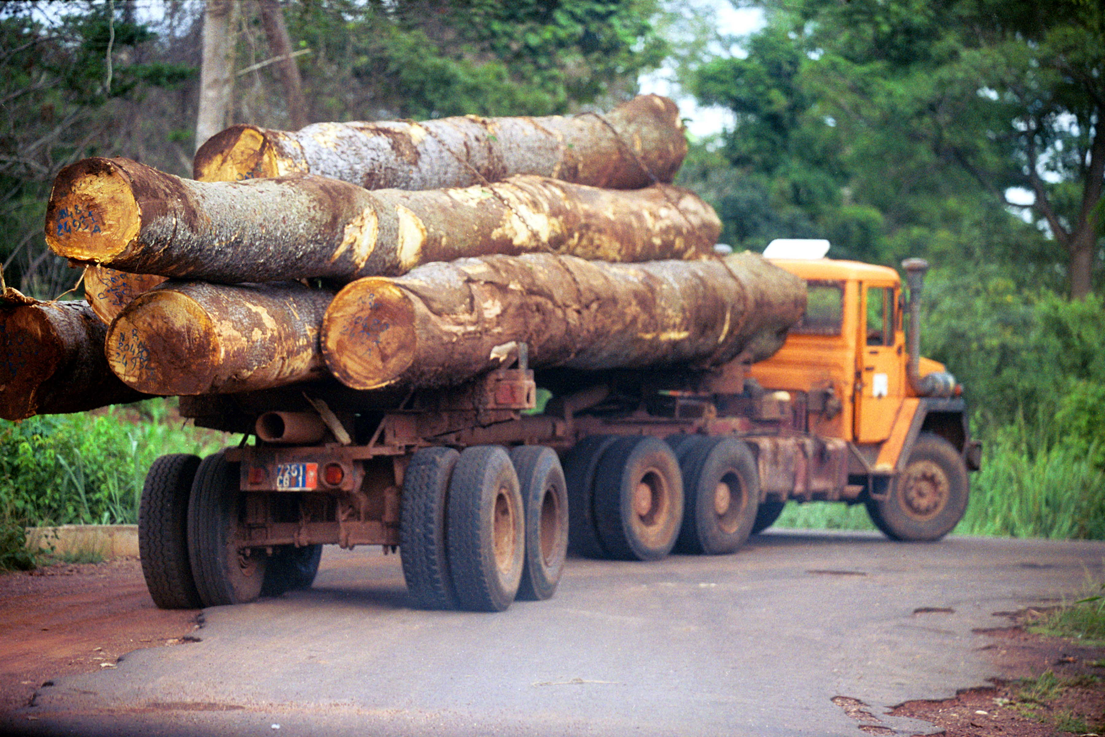
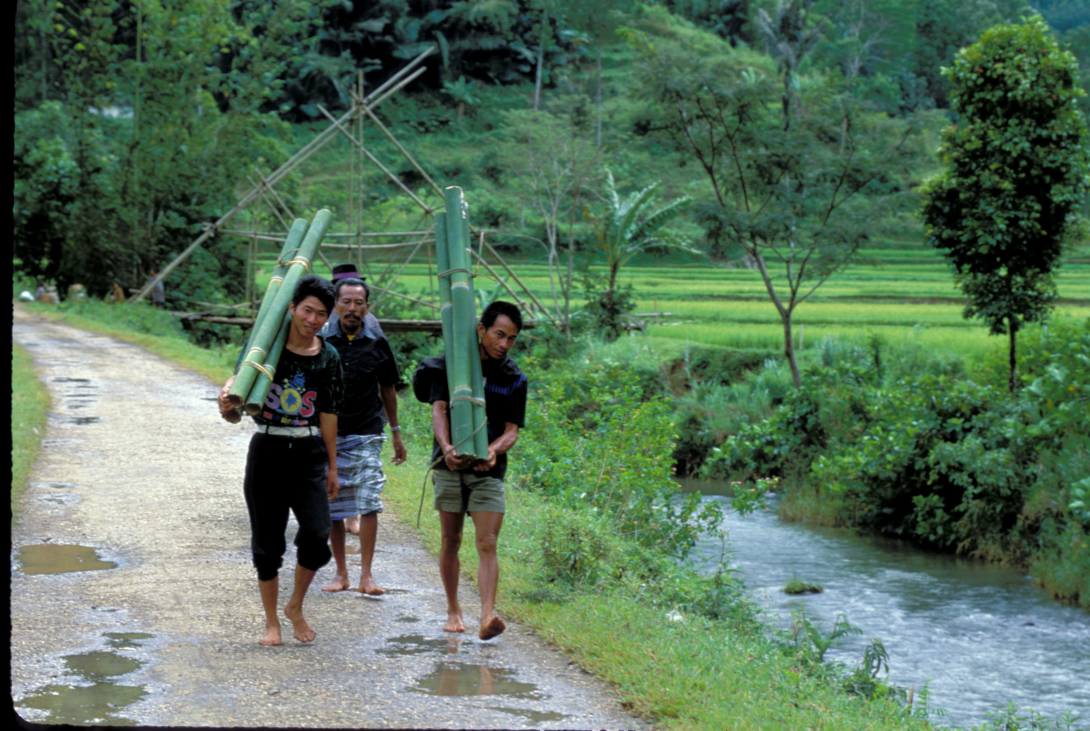
… and to the global economy…
Production of wood and manufactured forest products contribute more than US$450 billion to the world market economy.
The annual value of internationally traded forest products totals US$150-200 billion.
Globally, forest based industries provide about 47 million full time jobs.

Slide 14
… and the environment
Forest destruction is responsible for global biodiversity losses of 2-5% per decade;
Forest destruction (especially though burning) is estimated to contribute between 10 and 30% of all carbon gas emissions into the atmosphere; slowing deforestation and restoring forests are important elements of a strategy for slowing global carbon emissions.

Slide 15
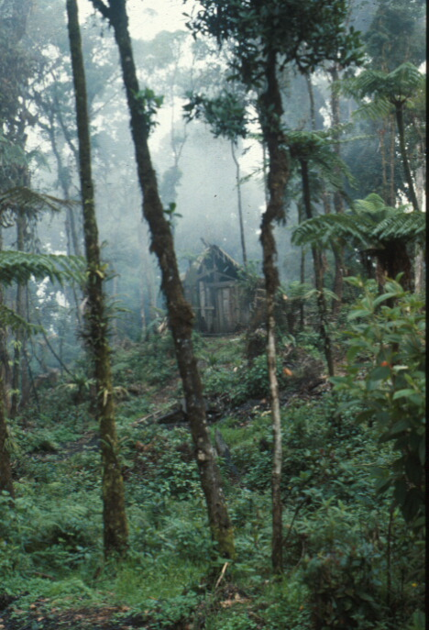
3 Pillars of Sustainable Forestry
Harnessing the potential of forests to reduce poverty
Integrating forests into sustainable economic development
Protecting local and global forest values

Slide 16
Making forestry sustainable
Supporting the development of policies and projects for sustainable forest management and conservation;
Building capacity for improved governance;
Supporting the containment of illegal activities;
Addressing fiscal and trade issues related to forest sector and products;
Proactively promoting catalytic investments in forest management and conservation.

Slide 17
Improving governance requires
Institutional reforms/building
Political accountability
Competitive private sector
Public sector reform (including judiciary and police)
Civil society participation

Slide 18
Institutional reforms
Establish clear property rights
Establish well-defined permanent forest estates
Reduce distortions to trade in forest products
Set the “right” level of forest taxation and rent capture
Simplify forestry legislation and strengthen implementation

Slide 19
Examples of institutional reforms
Philippines: Multisectoral Forest Protection Committees
Cambodia: Forest Crime Monitoring Unit
Brazil: Geo-referenced licensing system and identification of illegal logging from land-use monitoring via satellite imagery
India: Village Forest Protection Committee (Joint Forest Management)
Bolivia: Legislative reforms conferring greater responsibility to individuals and local communities
Ecuador: Independent certifiers and outsourcing of supervisory functions of the forest department
Ghana: Timber Utilization Contracts

Slide 20
Protecting local and global values
Build markets for international public goods such as carbon;
Build national markets for environmental services;
Strengthen policies and investments in conservation and protected areas;
Assure that investments and programs do no direct or indirect harm to the permanent forest estate.

Slide 21
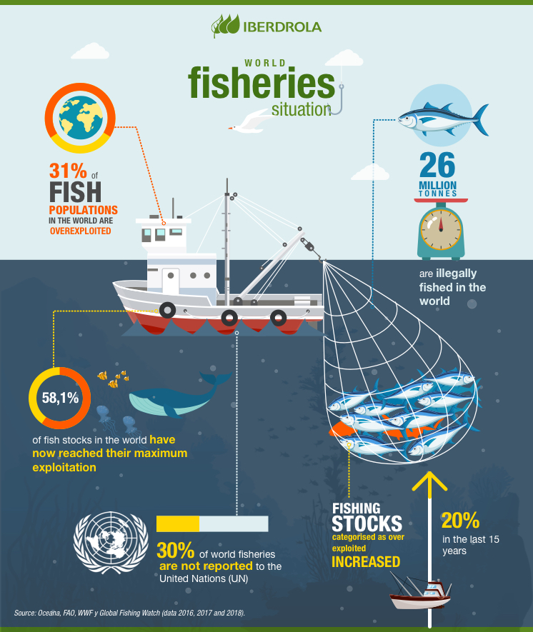
Sustainable Fisheries

Slide 22

Why are fisheries so important to developing countries?
Trade and income generation on national and global levels :
Global trade of US$ 55-66 billion annually, with 50 per cent of trade from developing countries
A Major Source of Income and Export for developing countries: at least 13 developing countries where fisheries is more than 5 percent of GDP, e.g. Ghana; Senegal; Namibia;
License fee income.

Slide 23
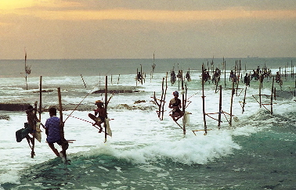
And important for poverty reduction
A Source of Livelihoods & Income for 30 million poor fishers and their families, employing an additional 150 million people in developing countries in associated sectors, e.g. marketing, boat-building, etc.;
A Critical Source of Food Security for 400 million poor people;
Potential source of alternative employment for rural poor through aquaculture.

Slide 24
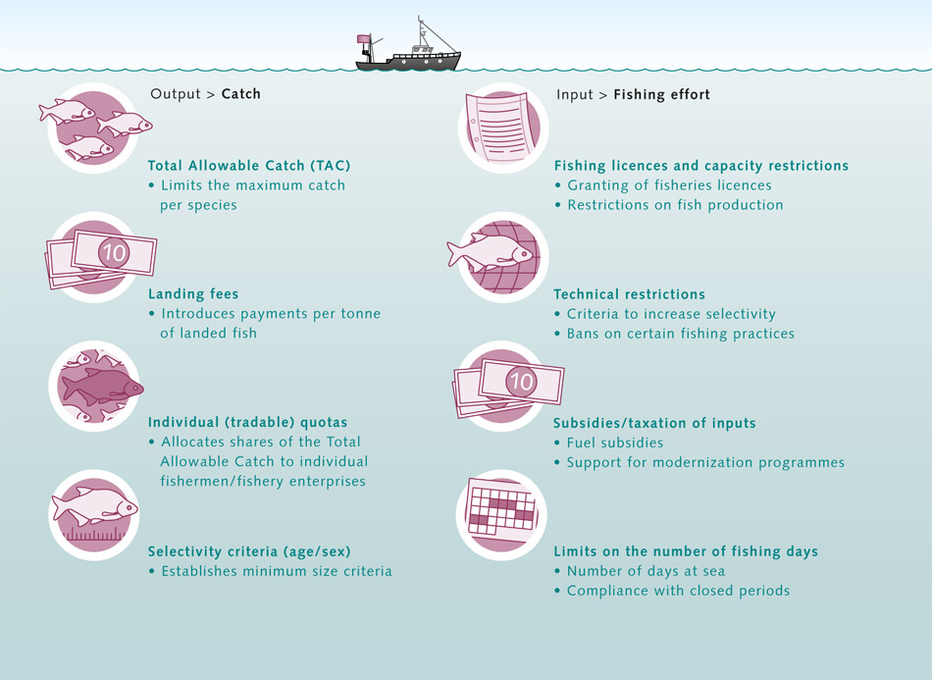
How??

Slide 25
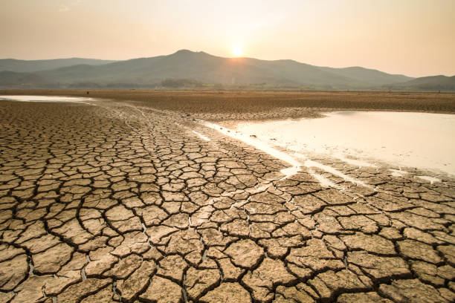
Global Warming

Slide 26
Prototype Carbon Fund (PCF)
Recognizing that global warming will have the greatest impact on its client countries, on July 20th, 1999 the Executive Directors of the World Bank approved the establishment of the PCF, with the operational objective of mitigating climate change. This aspires to promote the Bank's tenet of sustainable development, to demonstrate the possibilities of public-private partnerships, and to offer a 'learning-by-doing' opportunity to its stakeholders.

Slide 27
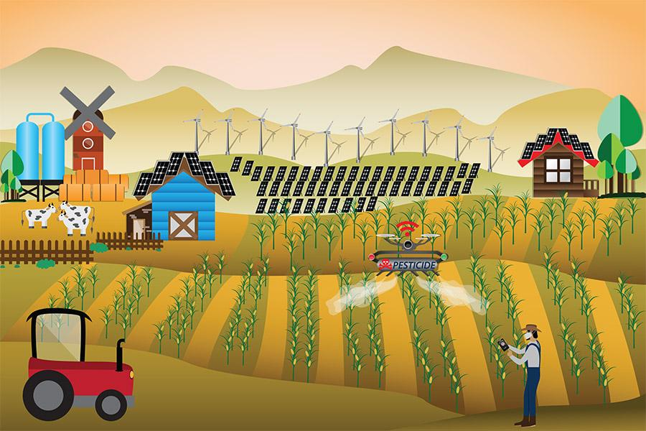
The Role of Trade in Agriculture and Rural Development

Slide 28
The Role of Trade
Agriculture (including fisheries and forestry products) is a highly tradable sector
Trade is the best lever for agricultural growth
Raising incomes mitigates pressure on the environment
Not all increases in trade are environmentally benign, but….
The best solution is generally to target the problem directly by adopting appropriate environmental policies, not to restrict trade, and…
Trade gives consumers a powerful lever to effectuate change in the supplying country (fair trade, certification)

Slide 29
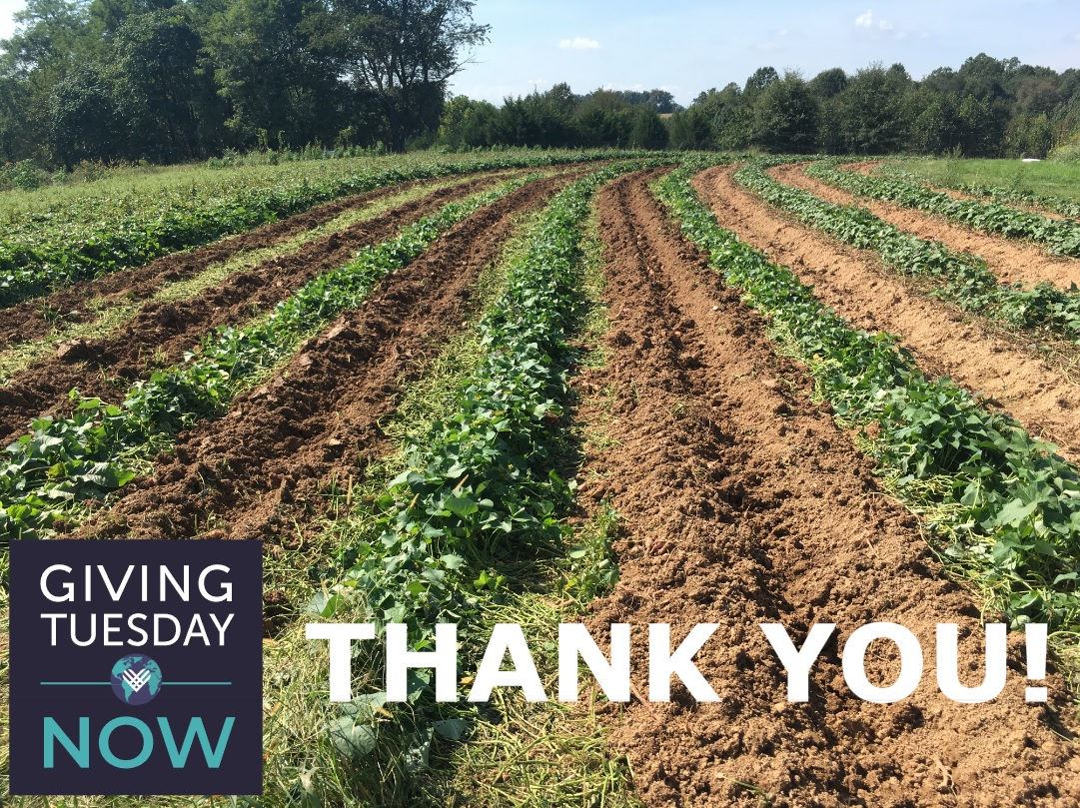

Thank
you

